Slide 1
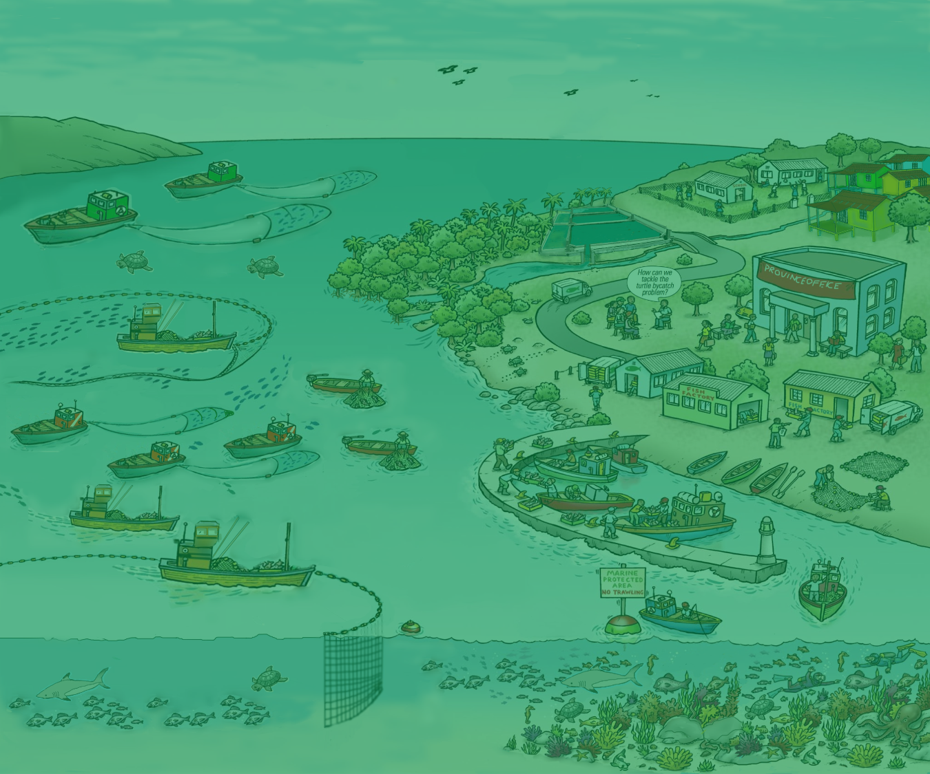
3. The what and why of EAFM?
Version 1

Slide 2
What is EAFM
EAFM is simply the ecosystem approach (EA) applied to fisheries management (FM)
EAFM = EA + FM
i.e. a practical way to implement sustainable development and sustainably maximize the ecosystem benefits of a fishery system
2

Slide 3
EA promotes sustainable development
GOOD GOVERNANCE
ECOLOGICAL WELL-BEING
HUMAN WELL-BEING
FOR FUTURE GENERATIONS
Notes:
Sustainable development can be thought of as a process that strives to balance human well-being (e.g. employment, profit and sustainable livelihoods) with ecological well-being (e.g. healthy fish resources and healthy environment) so that development achieved in one generation does impact development for future generations – our sons and daughters.

Slide 4
The 3 components - in a fishery context
Ecological well-being: e.g. healthy habitats, foodwebs, and sustainable fishing
Human well-being: e.g. Increased & equitable wealth, food security and sustainable livelihoods
Good governance: e.g. effective institutions and arrangements for setting and implementing rules and regulations
4
Notes:
Recap on the 3 components with examples for fisheries. Examples of ecological well-being include: healthy habitat protection and restoration, sustainable fishery resource and harvesting, pollution reduction of wastes. Examples of human well-being include: increased & equitably distributed wealth, sustainable livelihoods.

Slide 5
EAFM builds on what is in place
Builds on/improves existing management
Strengthens agencies through better planning and cooperation
Builds on and integrates co-management and other participatory approaches
Uses the traditional and scientific knowledge that already exists
Improves human capacity in skills needed for sustainable management
Notes:
EAFM recognizes that people skills are at least as important as having technical skills that help in understanding the resource, the environment and the technology.
EAFM requires better people skills, especially stakeholder analysis and engagement, participatory approaches, negotiation and conflict resolution

Slide 6
EAFM builds on existing fisheries management : “the move towards EAFM”
EXISTING
EAFM
EA/EBM
integrated management across sectors
multiple use management
target and bycatch
considers habitats
fishery impacts on the ecosystem
threats to the fishery from external factors
good governance/
participatory
socio-economic benefits
target species
fish focused
production driven
managed through control of fishing
government driven
6
Notes:
Moving from left to right we can see that EAFM, therefore, is a broadening of existing (or conventional) fisheries management that focused mainly on target species (species that could be eaten or sold). EAFM is the sectorial version of EA/EBM.
We, therefore, talk about “Moving towards EAFM”.
Multi-sectoral EA/EBM is also often aspired to (e.g. through considering large marine ecosystems).
Refer to Module 3, section 4, Table 2 Moving towards EAFM continuum.

Slide 7
Why EAFM?
Links fisheries management across jurisdictions and boundaries
Helps gain political and stakeholder buy in to fisheries
Increases support for better governance
- Can lead to better compliance and enforcement
Reduces conflicts, especially between different fishery sub-sectors
7
Notes:
Reinforcing the benefits of EA (discussed in session 2), EAFM has a number of benefits for fisheries, such as unlocking finances, gaining political and stakeholder support, increased support for better governance and reduces conflicts .
Refer to Module 3, section 3, Table 1: Features of EAFM, which outlines in more detail how EAFM specific features can help address the threats and issues identified earlier.

Slide 8
Why EAFM?
Helps unlock financial resources for fisheries
Good planning and momentum fosters support from governments, donors and NGOs
Helps protect the fishing sector from impacts of other users
Protects sub-sectors from negative impacts on each other (e.g. large-scale vs small-scale)
Promotes better communication and trust
8
Notes:
Other benefits include: protecting both the fishery sector against others and the fishery sub-sectors against each other. Allows for broader-scale management, and, most importantly, promotes better communication and trust.

Slide 9
EAFM complements other approaches
Co-management
Existing fisheries management
Integrated coastal zone management
EAFM
Marine spatial planning
EA/EBM
9
Notes:
EAFM complements other approaches that you may know:
The all-encompassing circle is EA/EBM. Within this we have:
co-management
integrated coastal zone management (ICM or ICZM),
Marine spatial planning (MPS), and existing fisheries management.
All of these approaches recognize that management must deal with broad ecosystem management (both natural and human components) and try to optimize the social and economic benefits.
Other approaches, such as Large Marine Ecosystems (LMEs) are similar, but at a different scale.
Diagram shows relationships – actual degree of overlap will vary from country to country – but not too extremely, e.g. so that EAFM falls fully within ICM.
Let participants explain why they think that circles should be moved to reflect the situation in their particular country.

Slide 10
Co-management: - a partnership arrangement between government and users for management (more later) - forms part of EAFM Integrated coastal zone management: - an ecosystem approach to managing a coastal area - links with EAFM in the coastal zone.
Other management approaches
10
Notes:
There are a lot of other approaches that all have the same overall goals and principles. Here are 2 approaches that participants may have some knowledge of.
Continue on next slide.

Slide 11
Marine spatial planning: - planning that delineates user access based on the spatial and temporal distribution of human activities - an important tool for EAFM (zoning) Marine protected areas: - a clearly defined area to achieve conservation of nature, with associated ecosystem services and cultural values - another important tool for EAFM
Other management approaches contd.
11
Notes:
Here are 2 more approaches that participants may have some knowledge of.
NB. MPAs are a tool for EAFM, but do not equate to EAFM, as they cannot address all issues/elements that EAFM has to include.

Slide 12
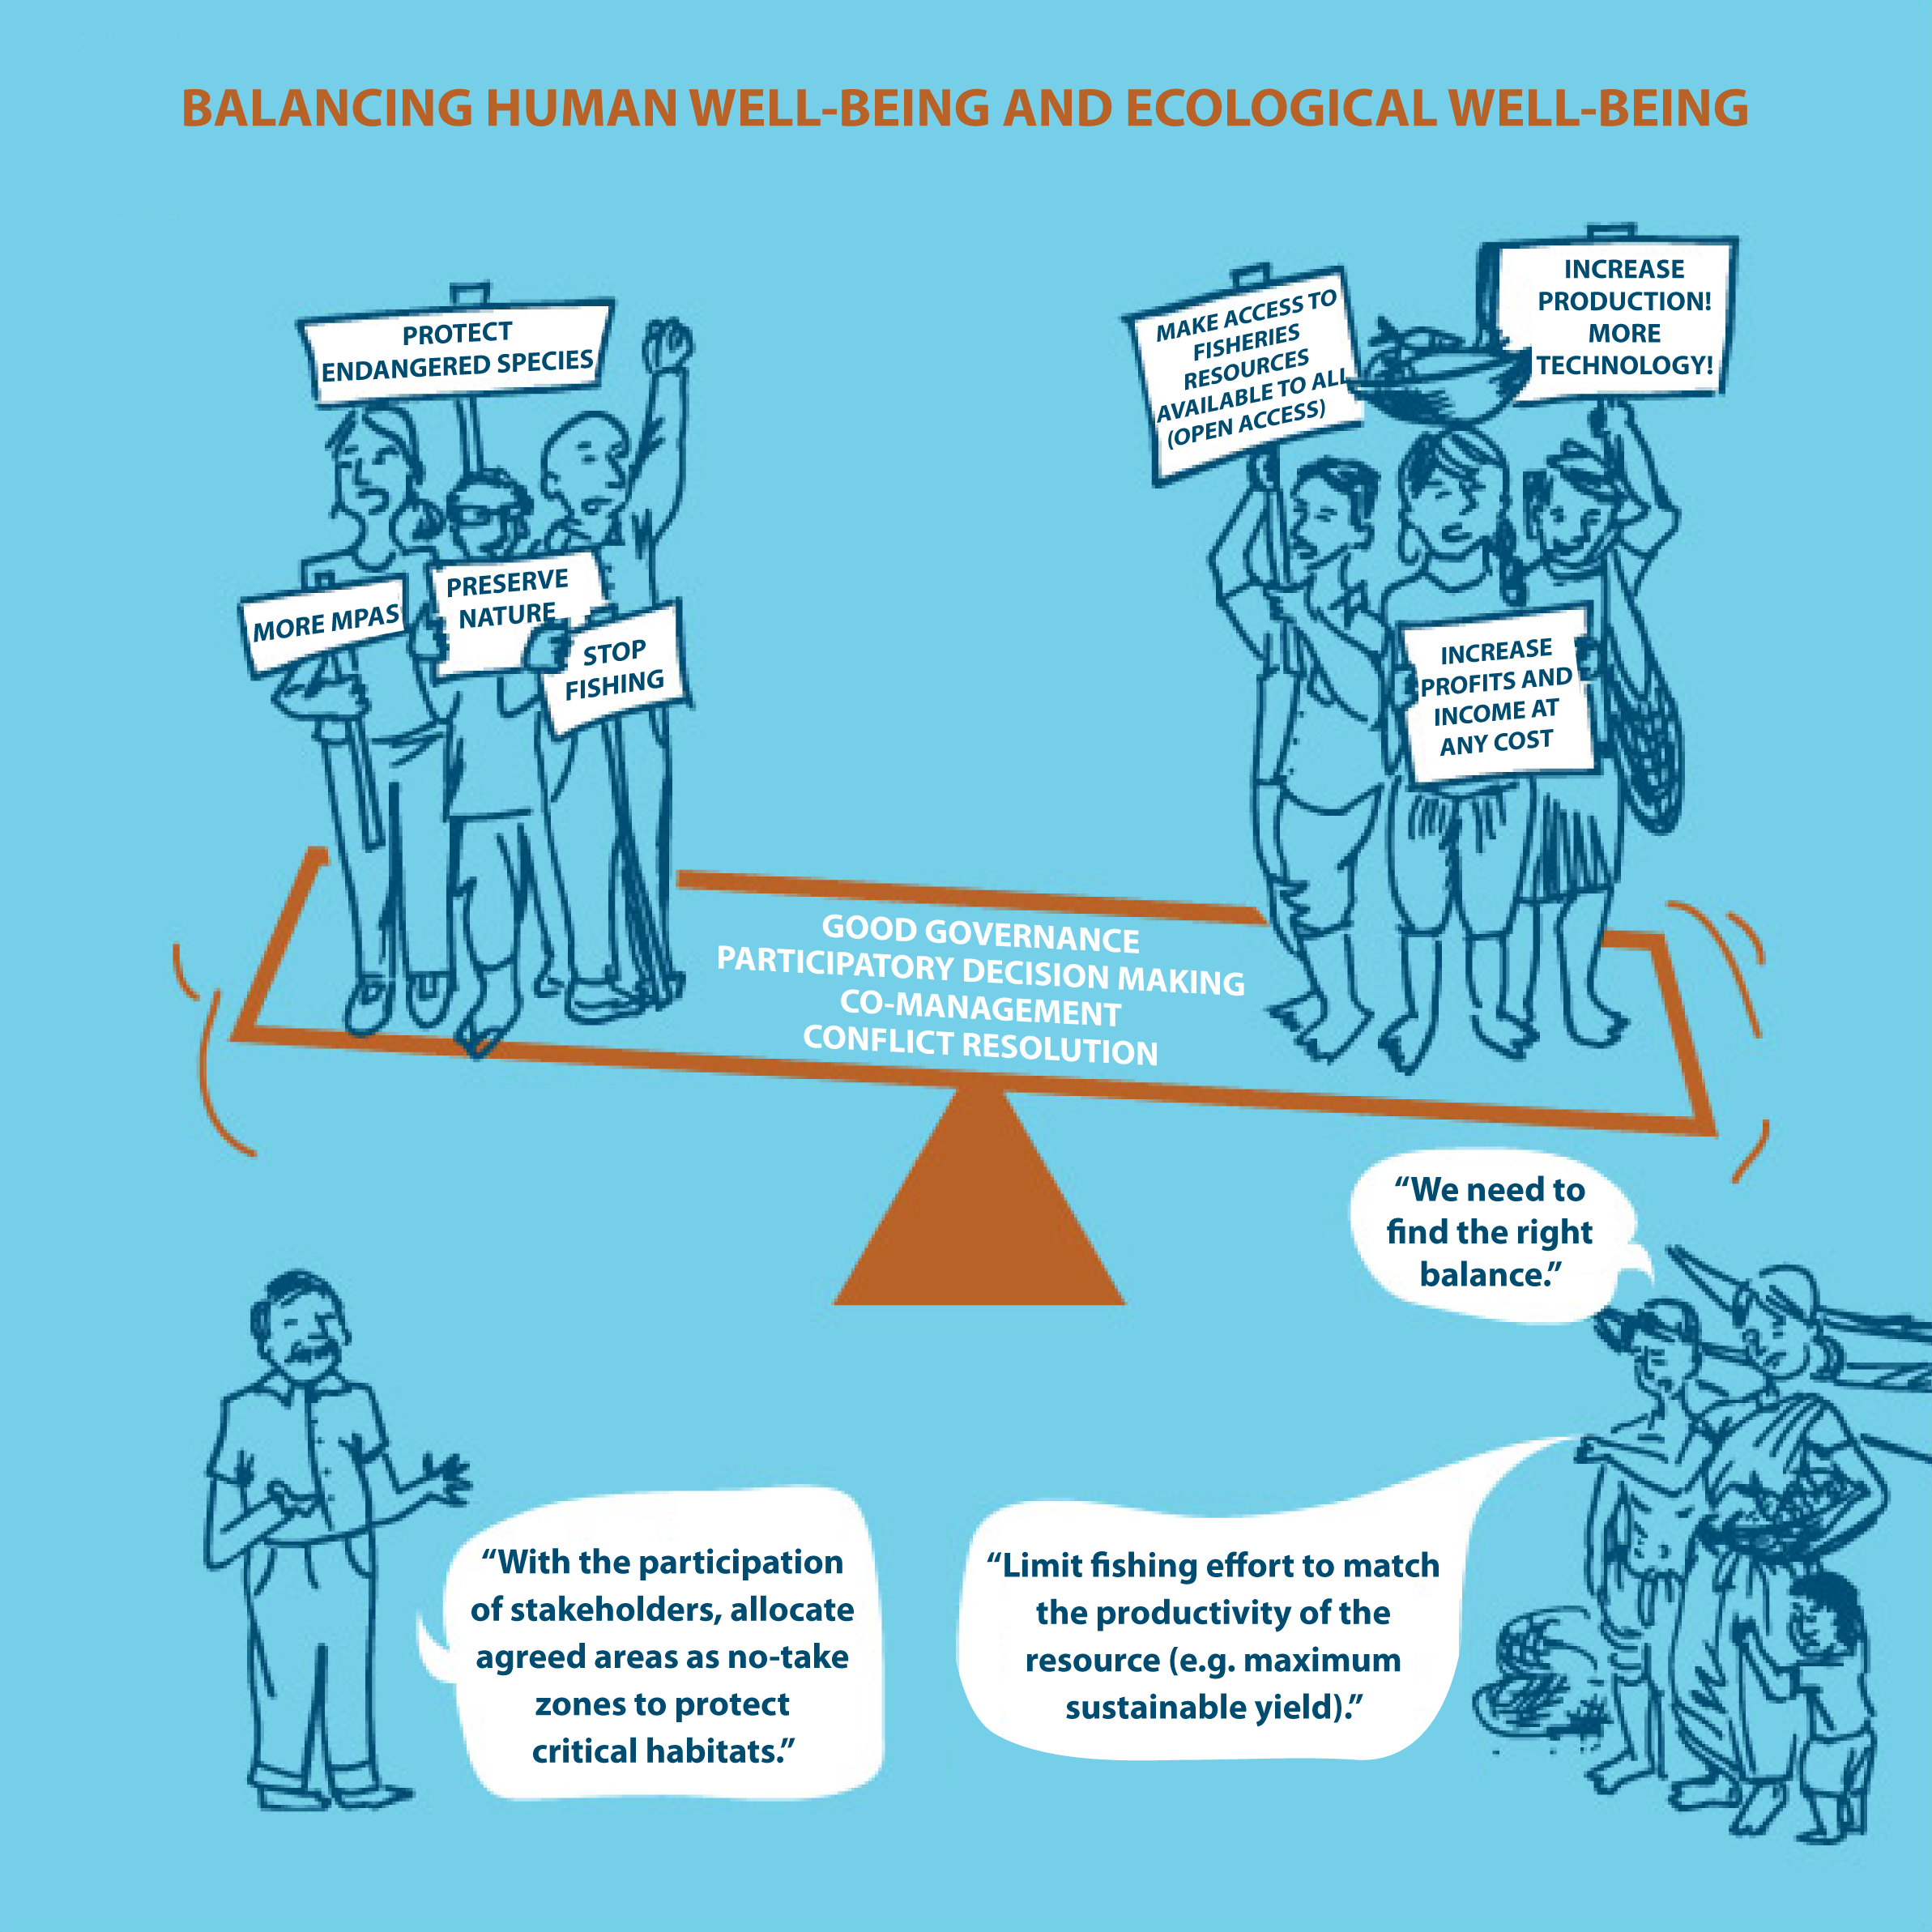
REMEMBER EAFM IS FINDING THE BALANCE
Adapted from ICSF (2013)
12
Notes:
NEW SLIDE. NOTE: we are waiting on the high res version from ICSF – will send next week – replace then
REMEMBER: EAFM IS FINDING THE BALANCE:
In this picture, we have the PRO-ECOLOGICAL-WELLBEING groups who want to ban fishing, put in more MPAs and protect endangered species. On the right we have the PRO-HUMAN WELL-BEING groups who want increased fish catches through increased technology, make fishery resources available to everyone and increase profits at any costs.
Under the seesaw we have a balanced solution in the case of participatory use of MPAs and limiting fishing effort.

Slide 13
Key messages
EAFM is simply applying EA to fisheries management (FM) and has 3 components:
Ecological well-being
Human well-being
Good governance
EAFM is all about finding the balance
Many benefits of using an EAFM
Builds on existing management (i.e. we move towards EAFM)
EAFM compliments and overlaps other forms of integrated resource management (e.g. ICM)
13
Notes:
Self explanatory

